Slide 1


AUTOMATIC HEADLIGHT BEAM CONTROLLER FOR
AUTOMOBILE VEHICLE
GUIDED BY: PRESENTED BY:
DR. M.LOGANATHAN A.ADHITHYAN 927621BME304
KRISHNA CHARAN 927621BME313
V.VINOTH 927621BME339

Slide 2
CONTENT
Abstract
Introduction
Content
working
Advantages
Disadvantage

Slide 3
ABSRACT
Headlight of vehicles pose a great danger during night driving.
The drivers of most vehicles use high, bright beam while driving at night.
This causes a discomfort to the person travelling from opposite direction and therefore experiences a sudden glare for a short period of time.
This is caused due to the high intense headlight beam from the other vehicle coming towards the one from the opposite direction.
In this project, an automatic headlight dimmer which uses a Light Dependent Resistor(LDR)sensor has been designed to dim the headlight of our vehicles to avoid human eye effects.

Slide 4
INTRODUCTION
Motorists face a huge problem due to high beam light which falls directly onto their eyes when driving at night or foggy conditions .
There is medical effect associated with these phenomena. This effect includes temporary blindness, glare, fading effect of image and something causing accident leading to many lives.
Troxler effect is used to describe a kind of temporary blindness. It is otherwise known as the „fading effect‟. A study shows that if our eyes are exposed to a very bright light source of around 10,000lumens, we experience a glare.
vehicle manufactures have to think about the extra safety instruments and electronic controls to attach these products for giving to users a safety
The project is about to control high/low beam automatically

Slide 5
working
• Our own vehicle travelling at high beam The vehicle coming at the opposite side also travelling at high beam
• In our vehicle the LDR will fixed in the windshield nearer to viper system
• If the opposite vehicle comes closer to our vehicle means the LDR will produce the output voltage
• This voltage is given to the amplifier to amplify the signal and then given to PIC.
• PIC itself having inbuilt ADC, so that the analog form of output from LDR is converted to digital form

Slide 6
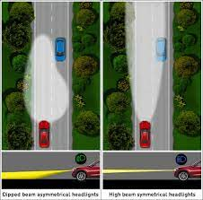
• This digital value is compared with the set value
• If it equals means the PIC microcontroller will send the signal to the relay circuit
• The relay circuit is acting as a switching circuit
• If the relay receives the signal from microcontroller, it change from NO to NC
• Due to this our vehicle will switch to low beam
• The opposite vehicle driver doesn‟t experience any sudden glare, so that he will cross our vehicle safely
• Once the opposite vehicle get crossed, our vehicle switch to high beam

Slide 7
BLOCK DIAGRAM

Slide 8
THE SYSTEM CONSISTS
LDR SENSOR
AMPLIFIER
PIC MICROCONTROLLER
KEYPAD
LCD
RELAY

Slide 9
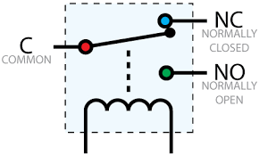
The relay’s switch connections are usually labeled COM, NC and NO
• COM = Common, always connect to this, it is the moving part of the switch
• NC = Normally Closed, COM is connected to this when the relay coil is off
• NO = Normally Open, COM is connected to this when the relay coil is on

Slide 10
ADVANTAGES
• It is an cost effective solution for the problem of night time accidents occurring during two way roads
• It can easily mounted on the running cars and low cost cars as an necessary
• Increased safety for drivers & pedestrians
DISADVANTAGES
• Continuous power supply from the battery for the sensor circuit

Slide 11


